Slide 1


Project
Summary

Slide 2


Today's agenda
Project recap
Problem
The Analytics team
Process
Insights
Summary

Slide 3

Social Buzz is a fast growing technology unicorn
that need to adapt quickly to it’s global scale.
Accenture has begun a 3 month POC focusing on these tasks.
An audit of Social Buzz’s big data practice
Recommendations for a successful IPO
Analysis to find Social Buzz’s top 5 most
popular categories of content
Project Recap

Slide 4

Problem
Over 100000 posts per day
36, 500,00 pieces of content per year

Slide 5



The Analytics team

Slide 6
Process
1
Data Gathering
2
Data Cleaning
3
Data Modelling
4
Data Analysis
5
Extracting insights

Slide 7

Insights
1897 Reaction to Animal Post
16 Unique Categories
January

Slide 8
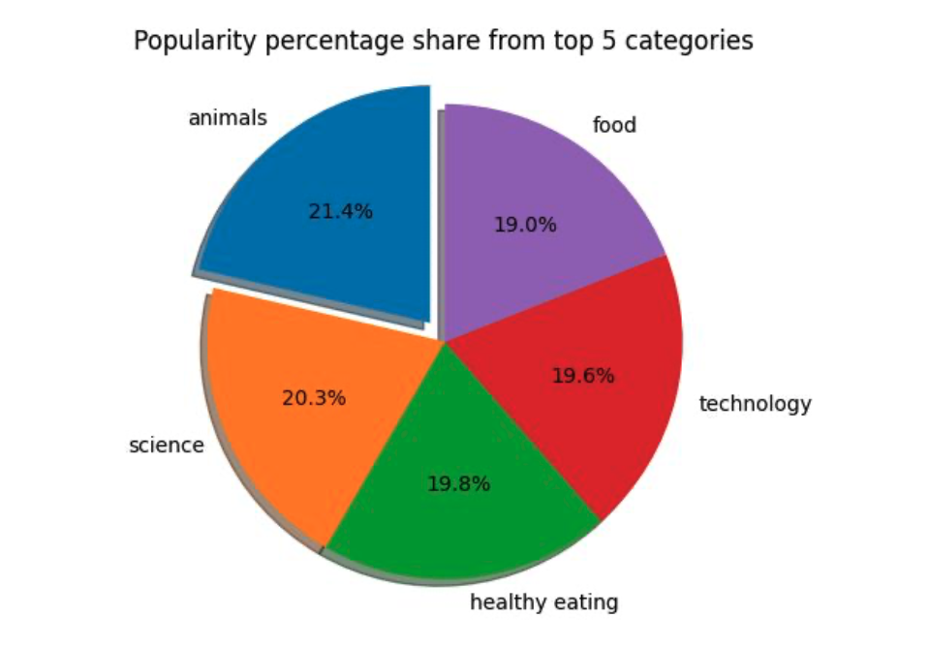

Slide 9
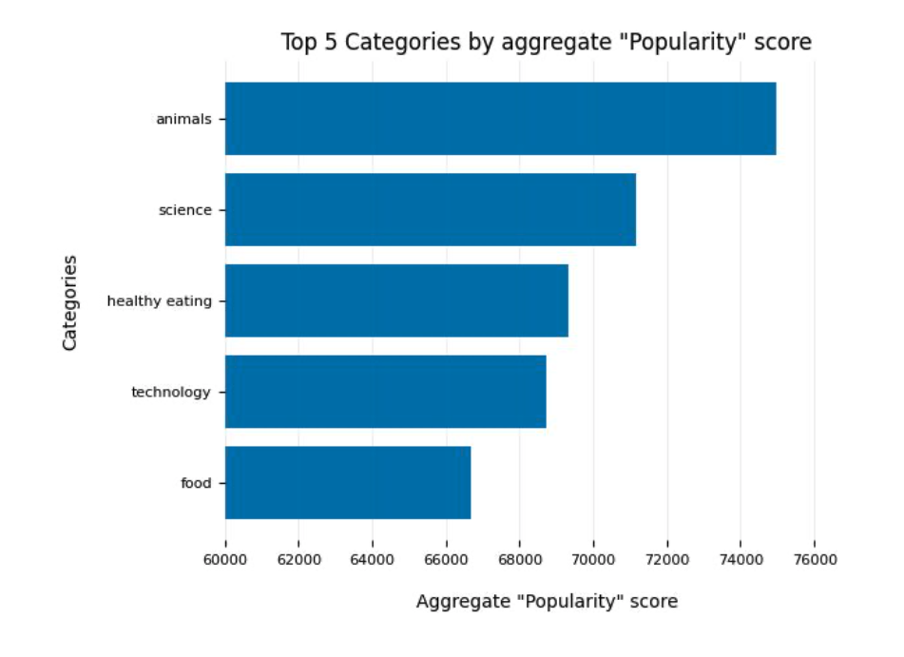

Slide 10
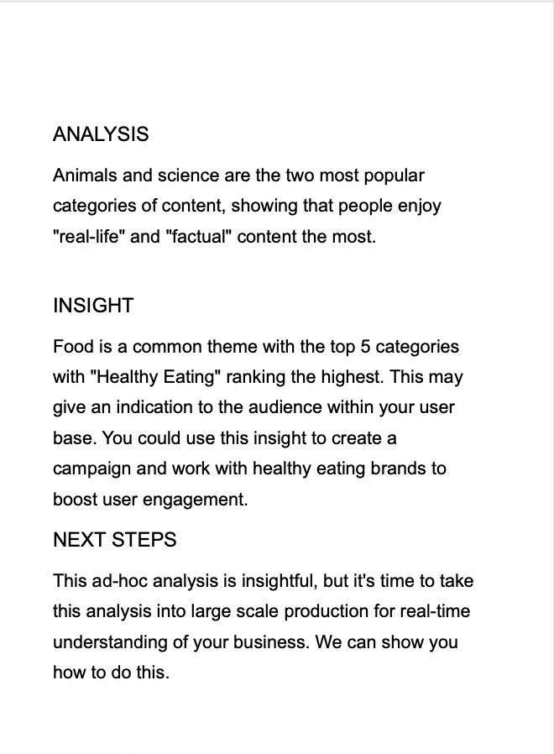

Summary

Slide 11
Thank you!
ANY QUESTIONS?

